Slide 1
Live Session 5 DS6306
Ben Goodwin

Slide 2
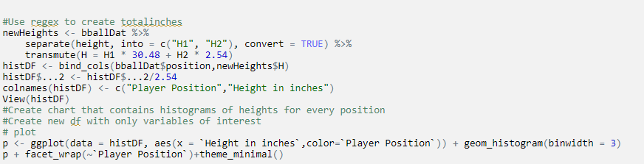
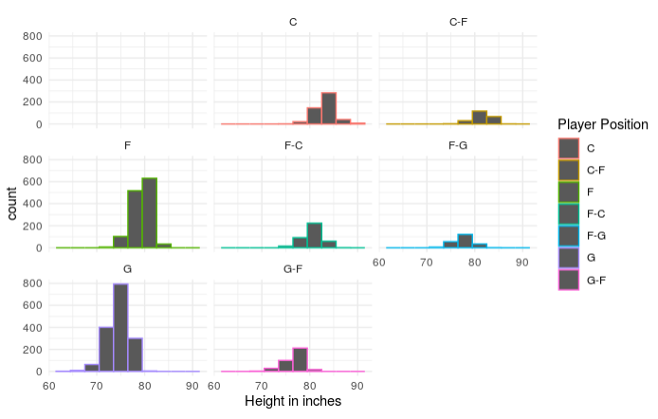
Basketball Study
R input for Part 1 and 2 (Regex and Histograms)

Slide 3
Basketball Study
Histogram of Player Position and Height (inches)

Slide 4
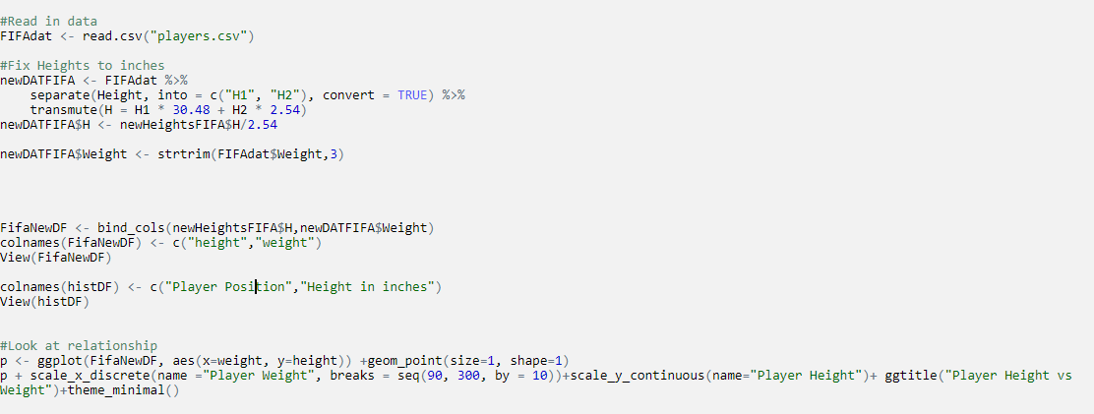
FIFA Questions
R input for Part 1 and 2 (Regex and Plot)

Slide 5
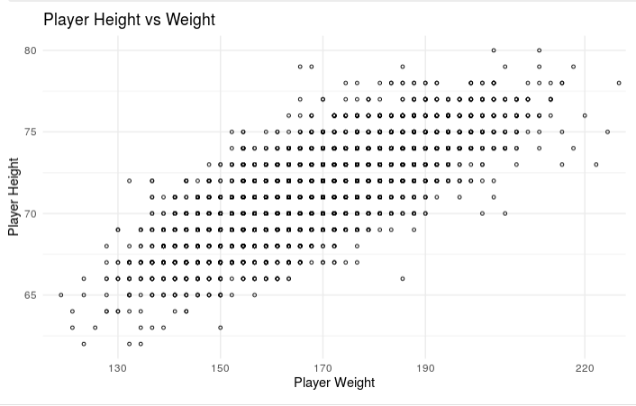
FIFA Questions
R out for Part 2 (Plot)

Slide 6
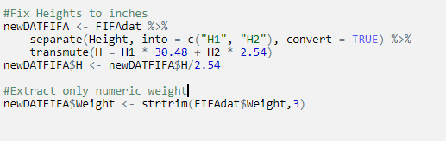
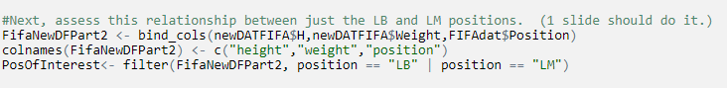
FIFA Questions
Relationship Between LB and LM
Plot input to study relationship (R)

Slide 7
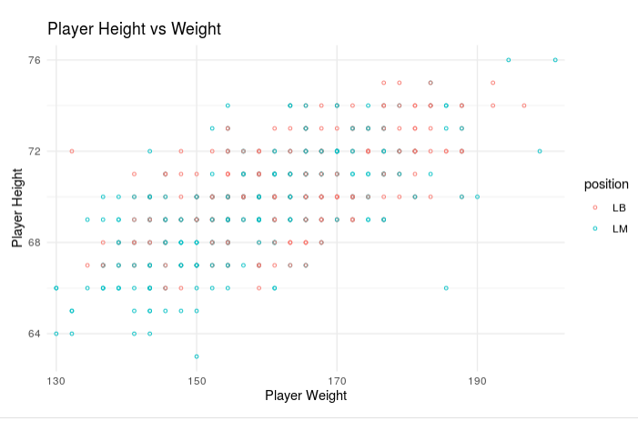
FIFA Questions
Player Height VS Weight (Position as color)

Slide 8
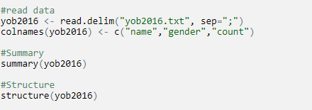
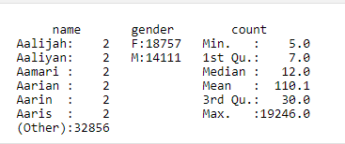
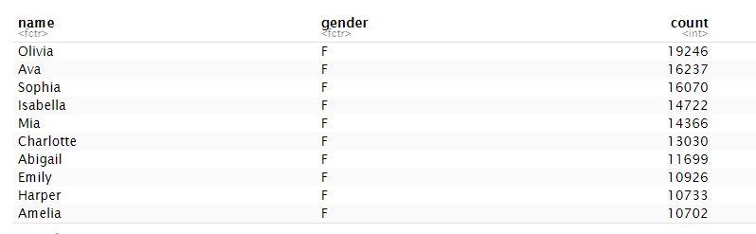
Baby Name Questions
Read in semicolon delimited data
Summary of data
Structure of data

Slide 9
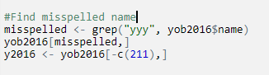
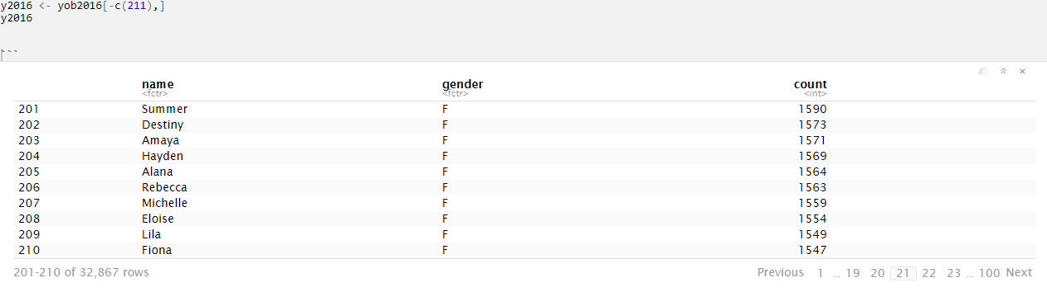
Baby Name questions
R input to find and remove misspelled name
R output for misspelled name
R input and output for new df without “fionayy”

